Slide 1
NUNTIUS
— User Flow Process
by Group7 Daniel Hwang, David Li, Bryan Zhang

Slide 2


The Problem—
Issues in current Education System

Slide 3



John Williams
Age: 41
Details:
Elementary school teacher,
Married
Eric Smith
Age: 37
Details:
software developer,
parent
Goals:
Create active learning environment
Invite parents to the education system
Goals:
Track kids’ performance
Collaborate with teacher
Mike Smith
Age: 12
Details:
Student, Grade 7
Goals:
Receive help on homework
Plan for tests

Slide 4
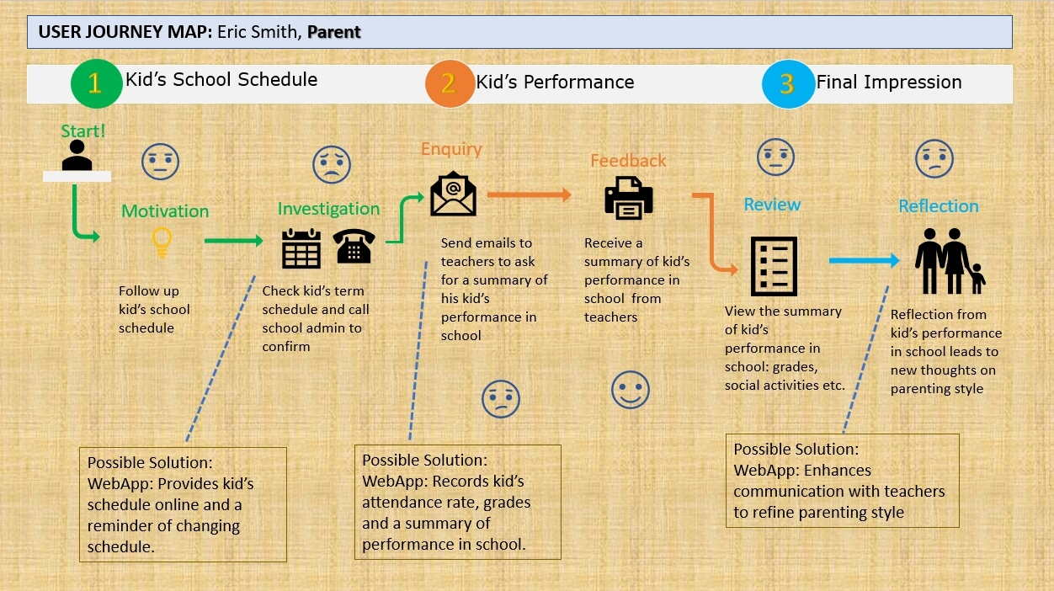
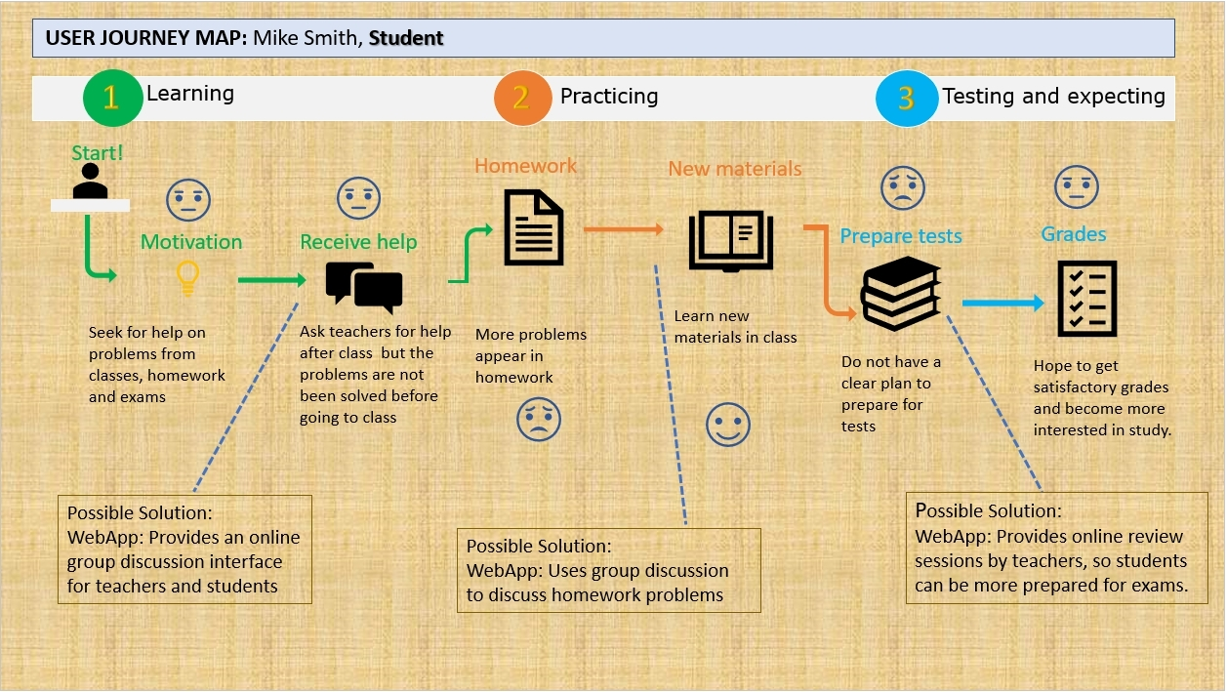
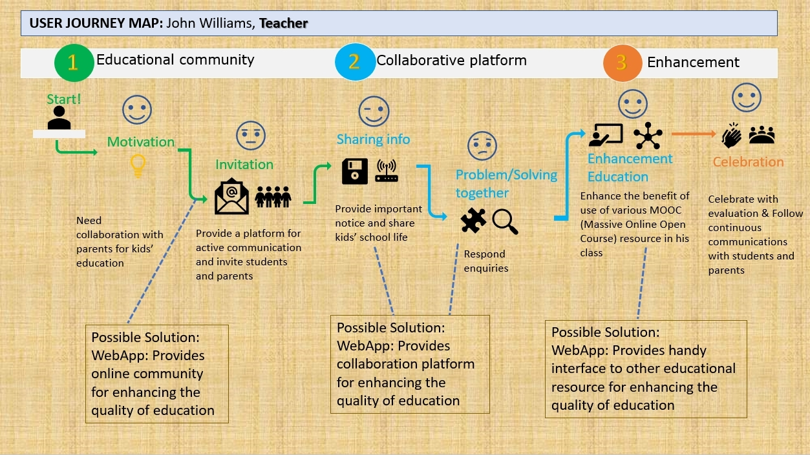

Slide 5

A GLANCE OF FEATURES
Absence Report
Group Study
Performance Record
Massive Open Online Courses
Events and Activities
Messaging System

Slide 6
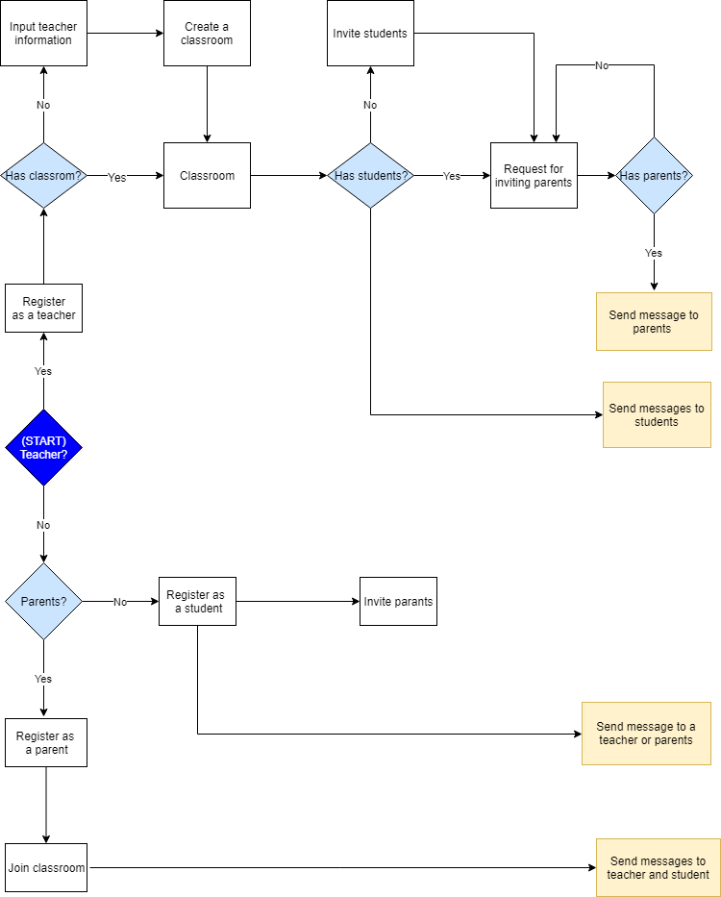
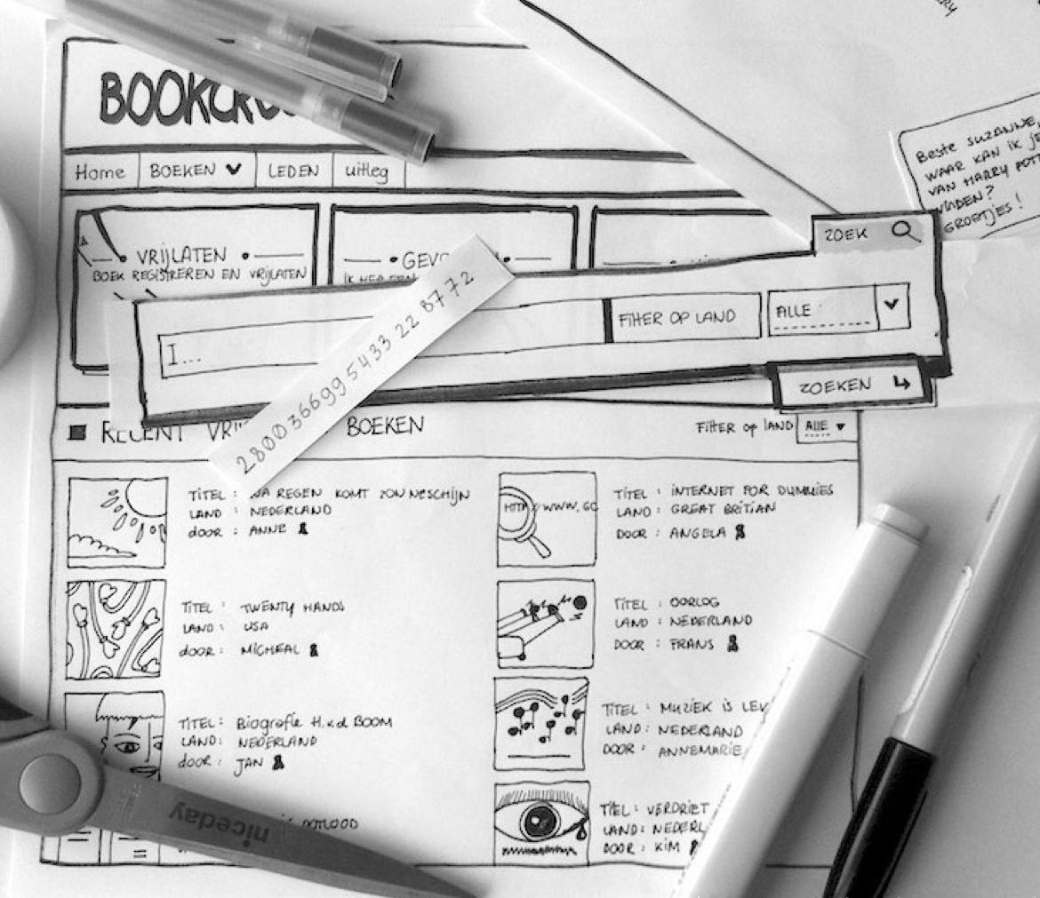
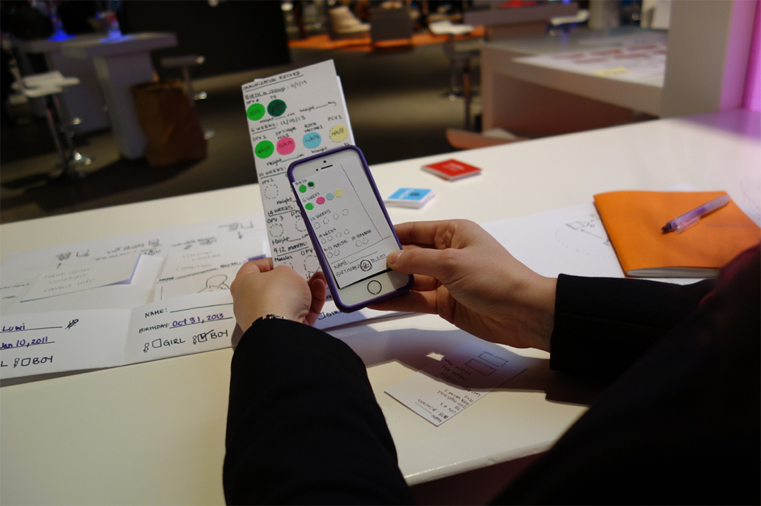
User flow: methodology and process
User Flow Chart
Prototyping
User Testing

Slide 7
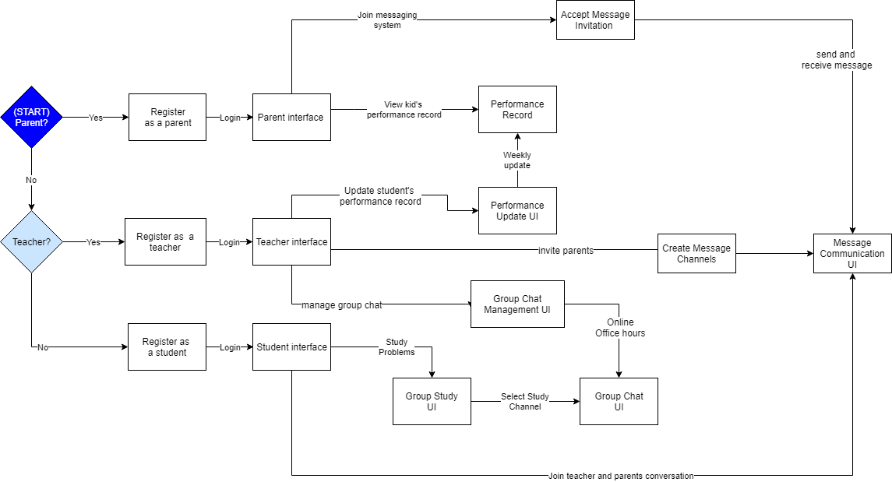
User flow

Slide 8
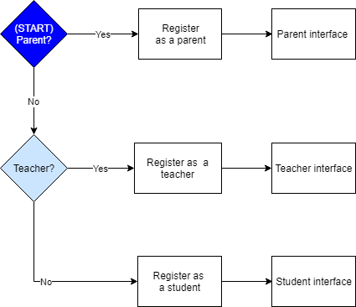
User flow

Slide 9
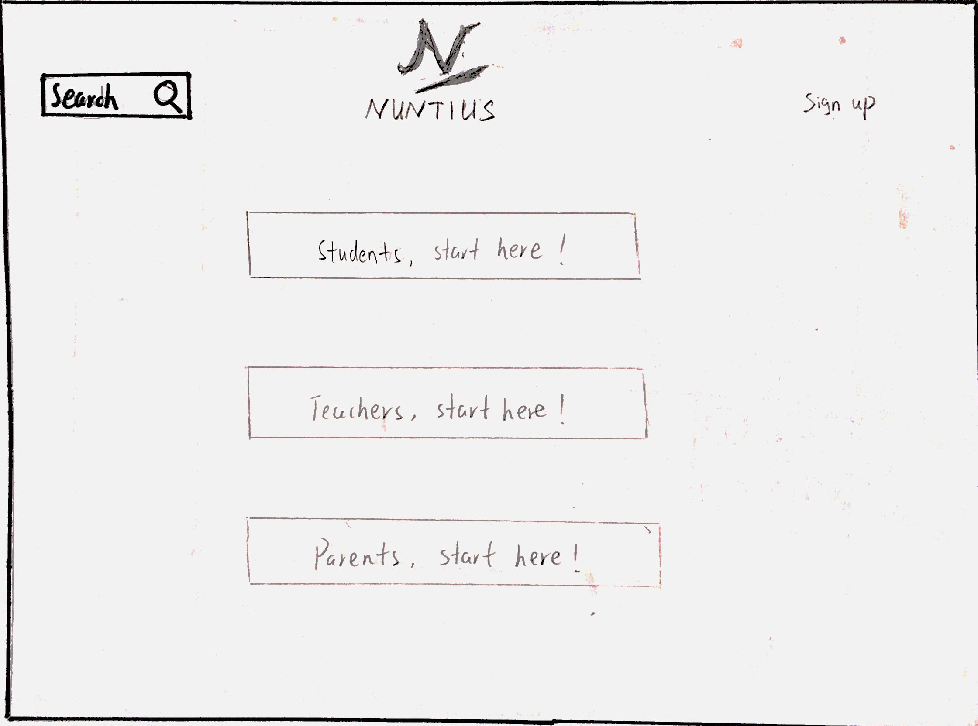
User flow

Slide 10
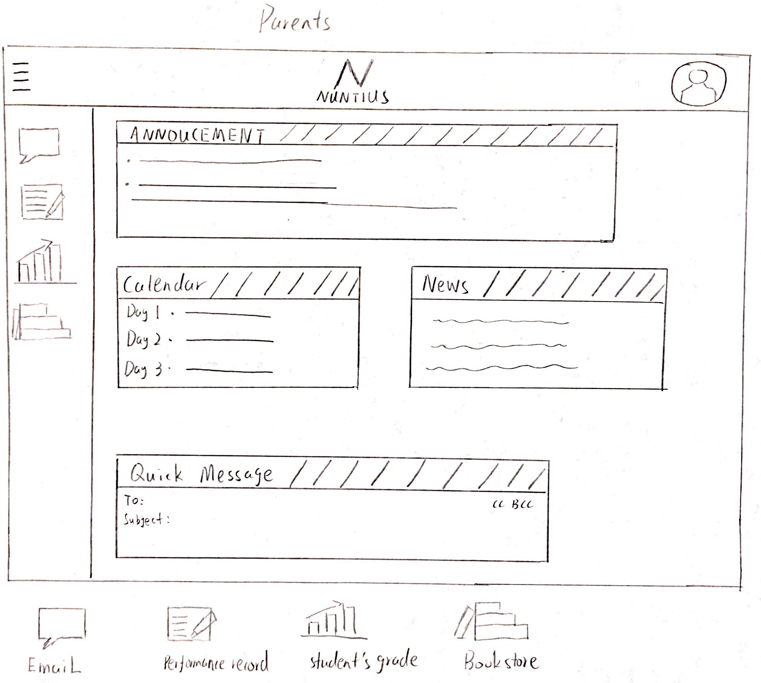
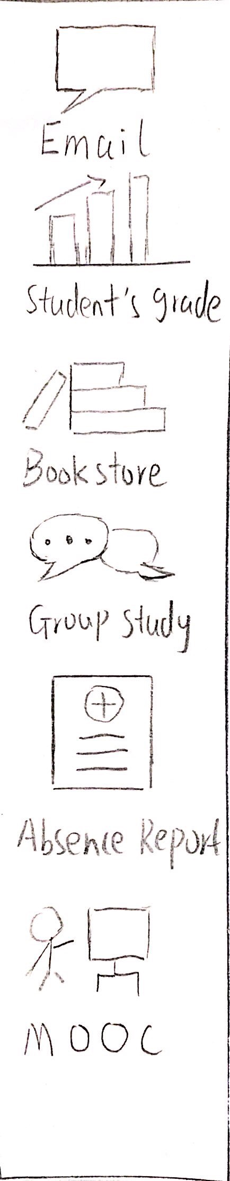
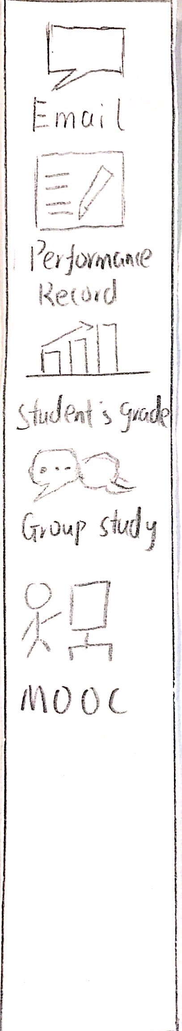
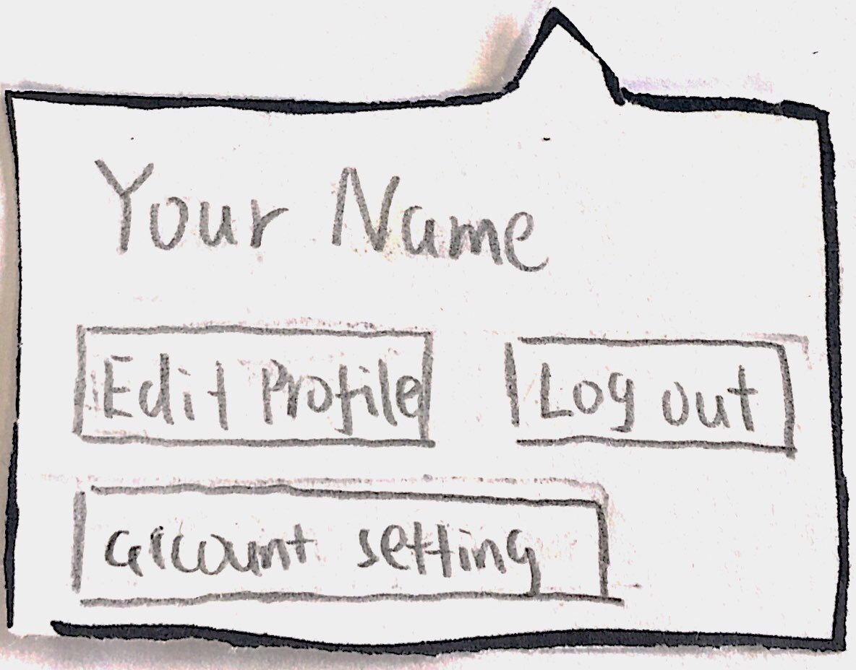
User flow

Slide 11
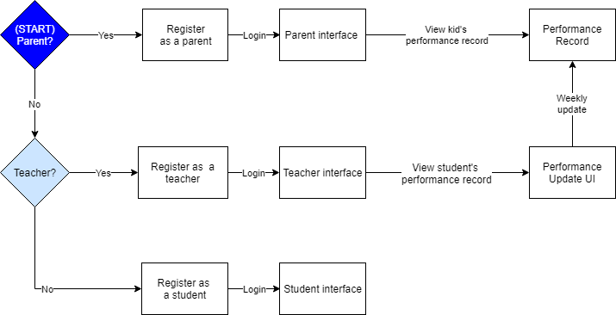
User flow

Slide 12
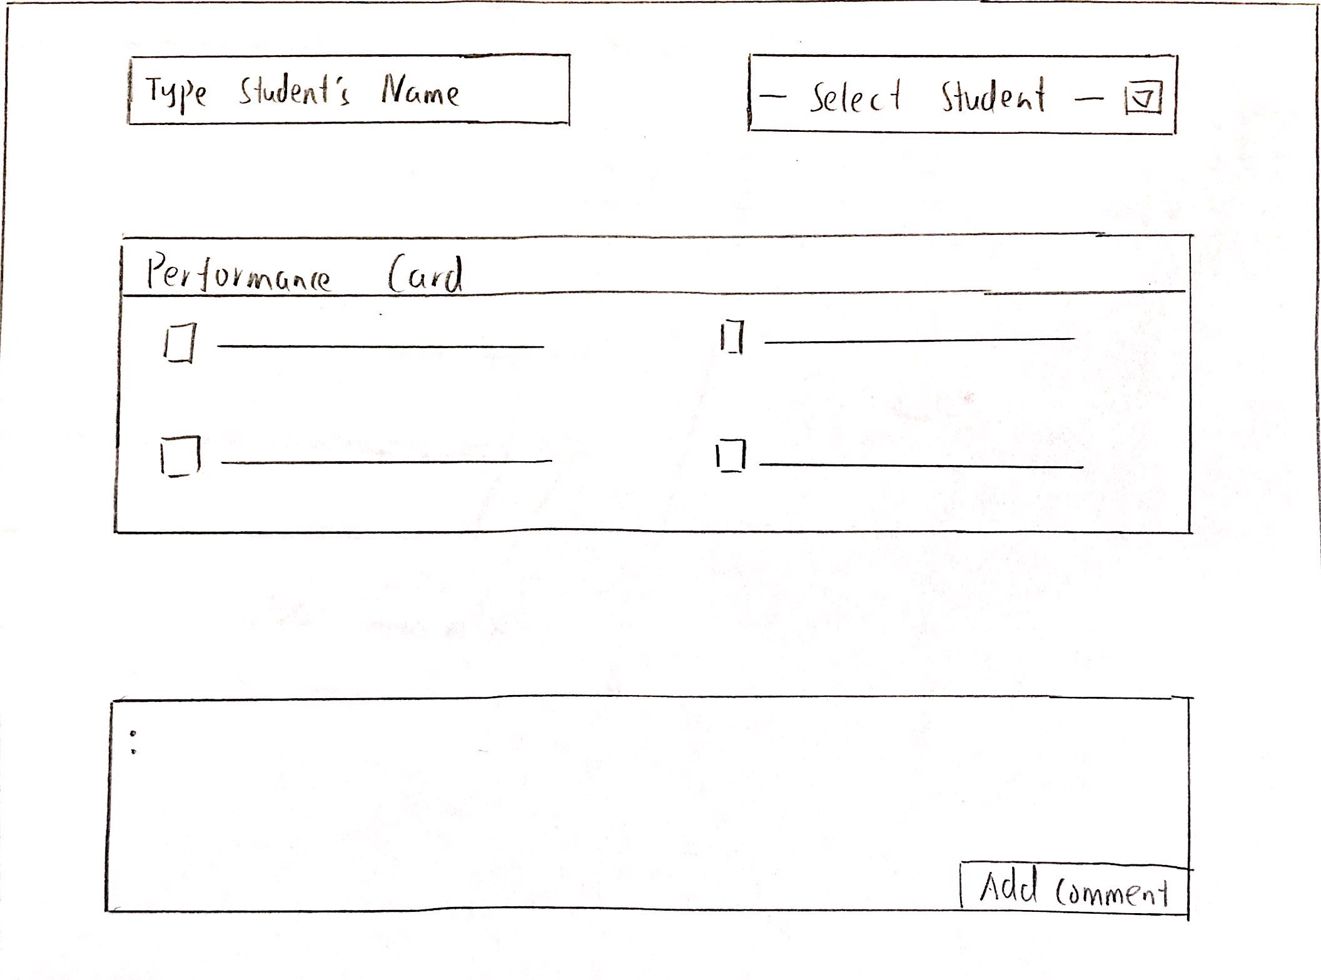
User flow

Slide 13
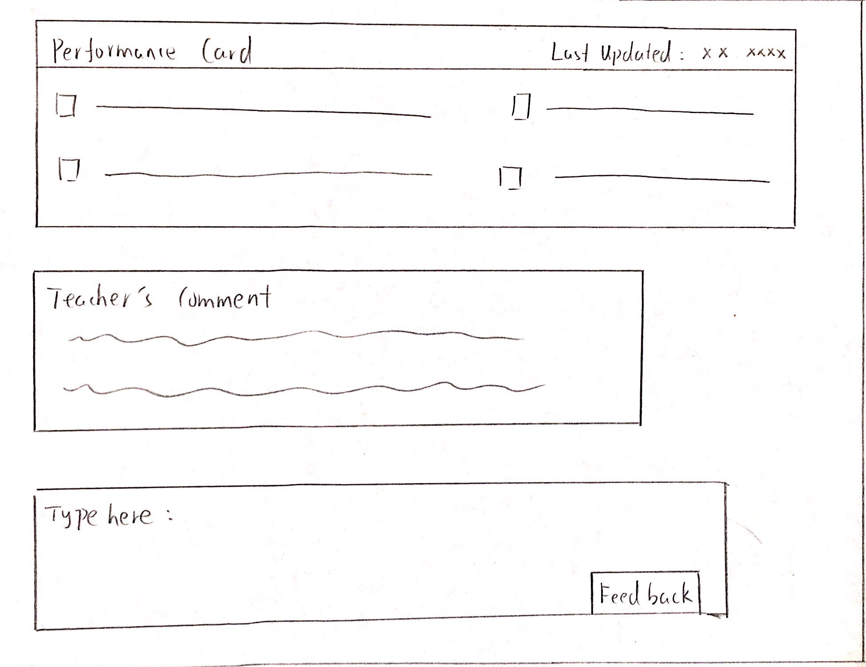
User flow

Slide 14
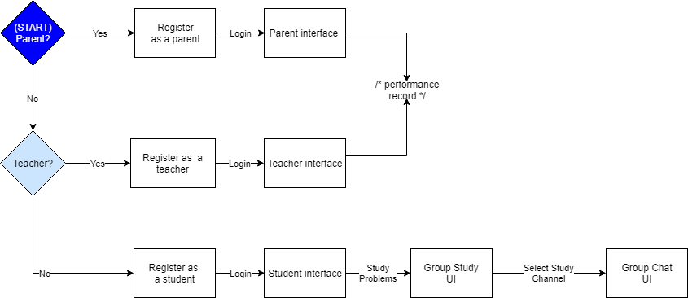
User flow

Slide 15
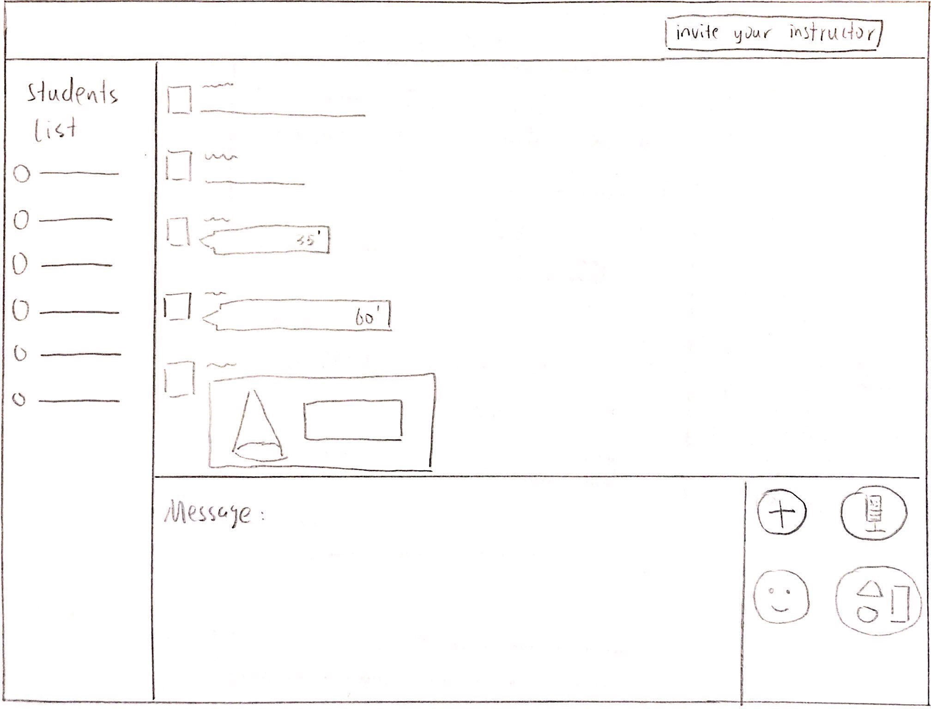
User flow

Slide 16
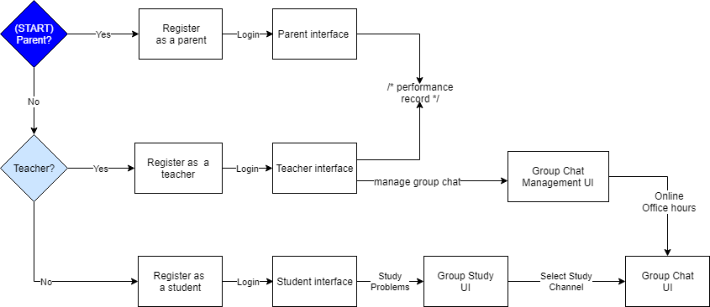
User flow

Slide 17
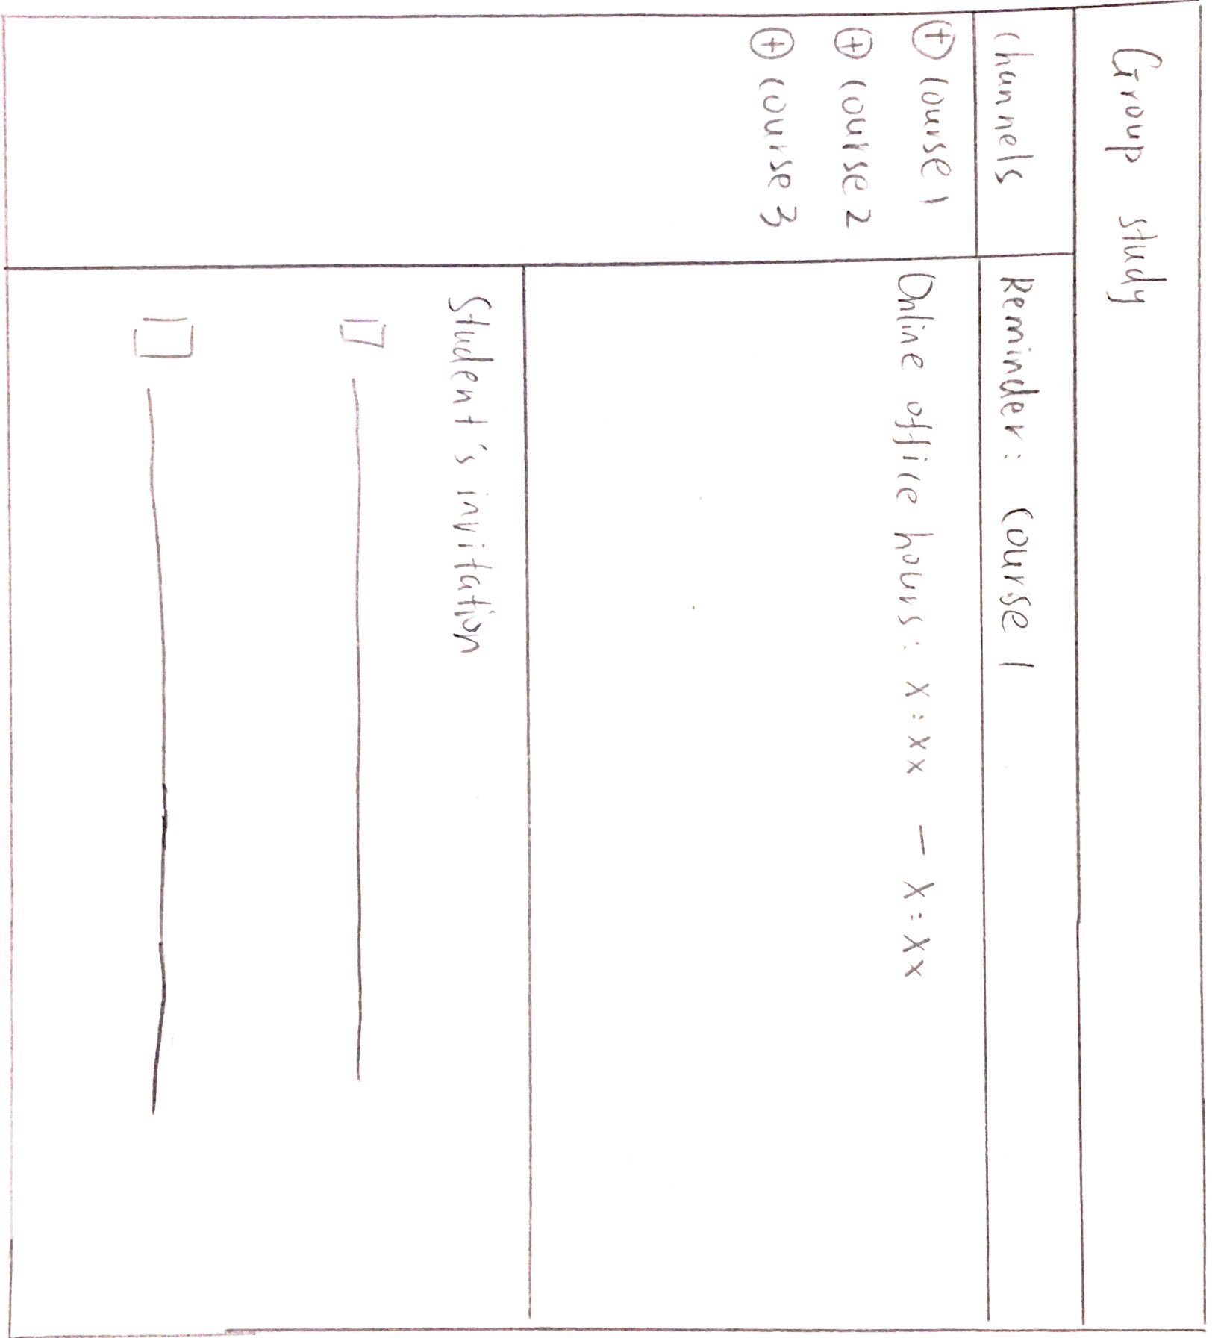
User flow

Slide 18
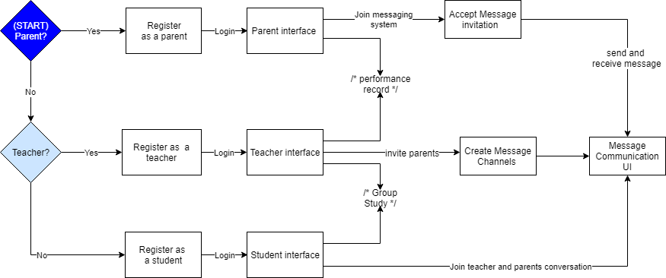
User flow
Notes:
Okay, the message system is the most essential part for co-operation among teachers, parents, and students. Teachers can create message channels according to topic and issues, and the participants can share the message immediately.

Slide 19
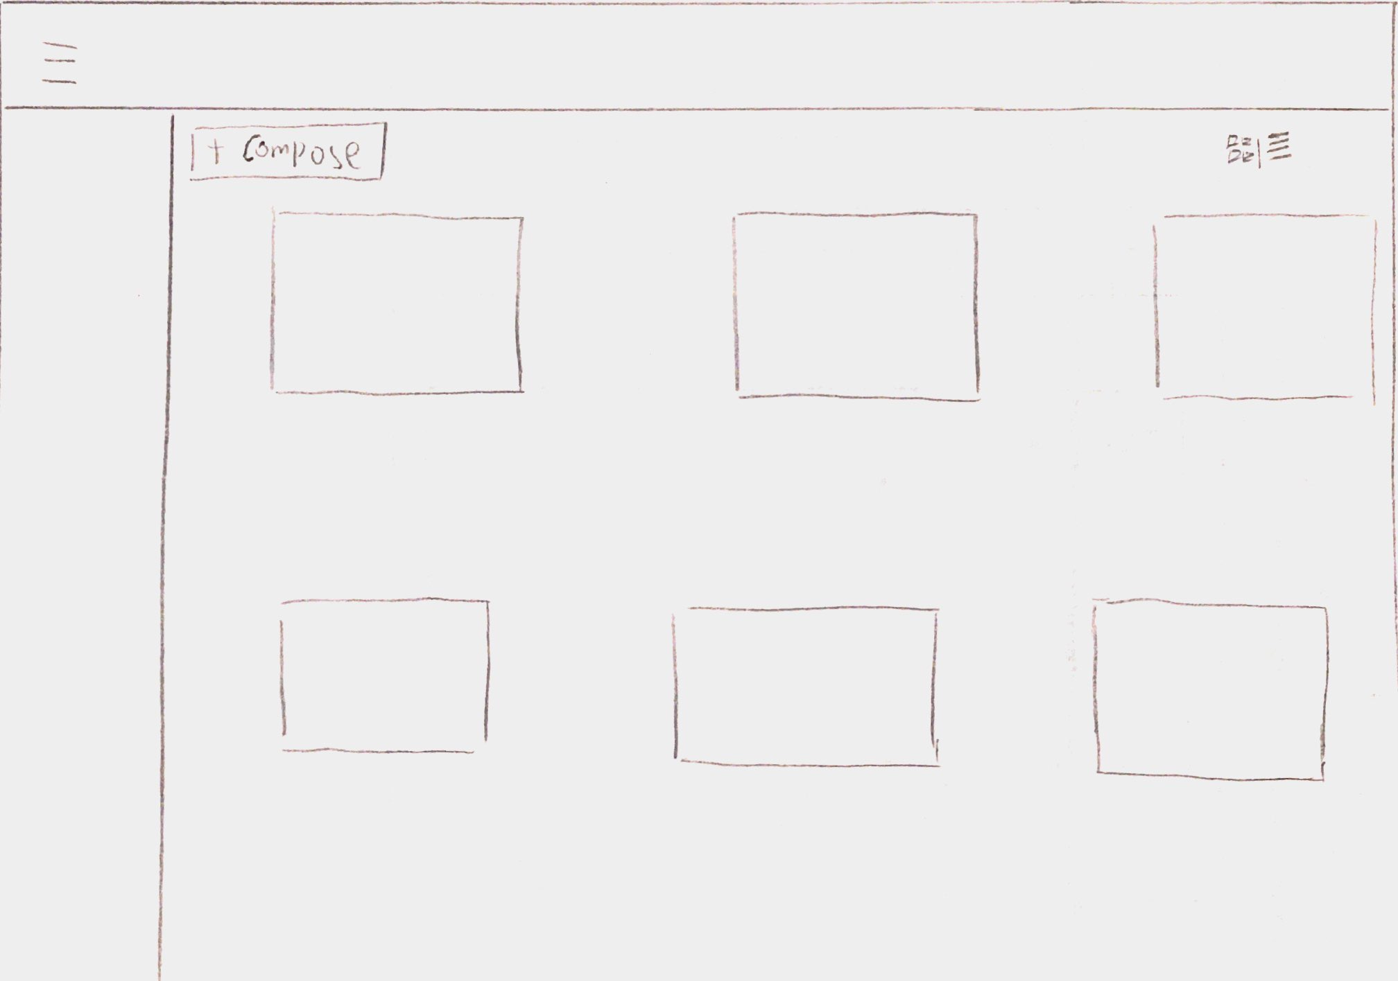
User flow
Notes:
Let’s see the front screen of message system.
Messages will be shown as cards or lists, which depends on user’s preference.

Slide 20
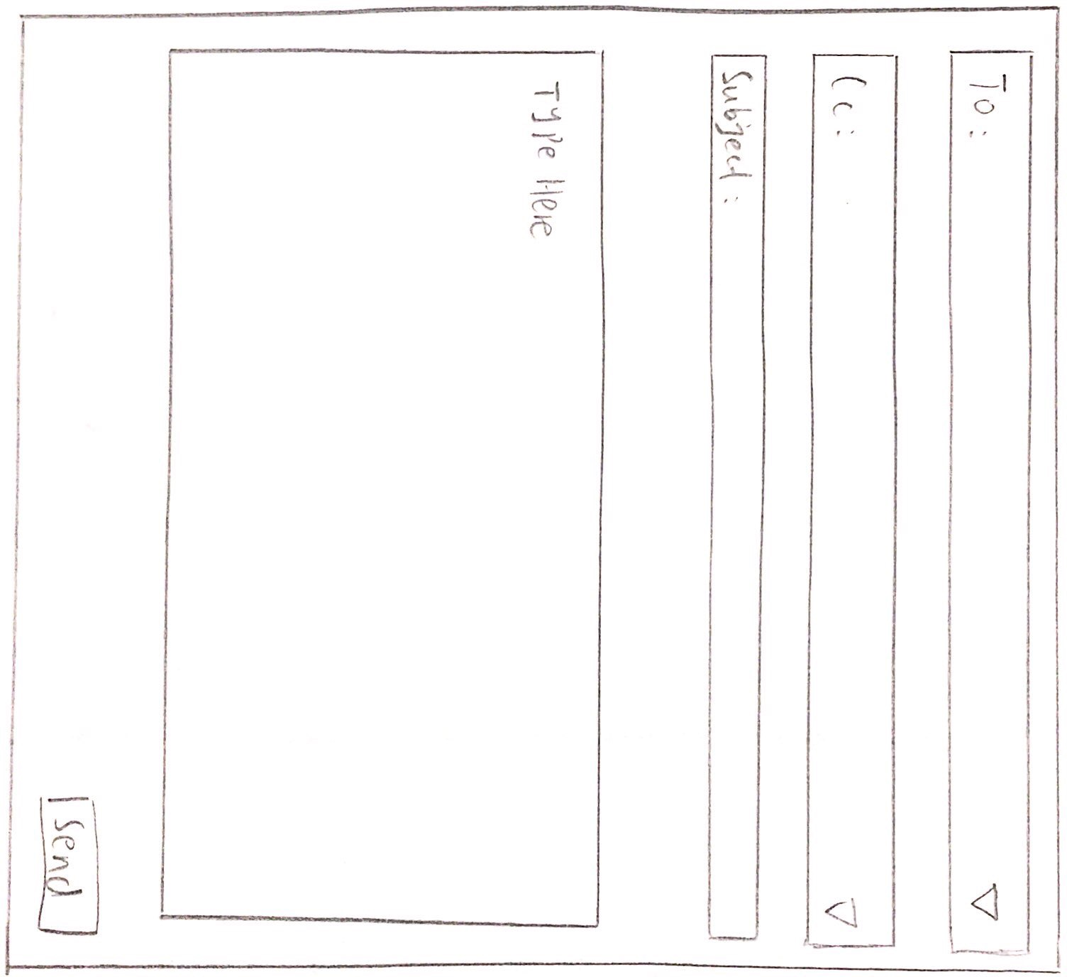
User flow
Notes:
This is the message composing screen. Originally, we do not include CC section in that.
However, through user testing, it is finally added because it provides frequently used features.

Slide 21
User flow
Notes:
Now, go back to the unified user flow! According to user type, our system provides 3 main interfaces. Each interface will provide 3 core features such as performance record, group study, and real-time message communication.

Slide 22
Planning for each sprint
UI development with HTML and CSS (for 3 features)
Build feature 1. - messaging system
Build feature 2. - performance record communication
Build feature 3. - group study platform
Notes:
Finally, closing our presentation, I'm going to show you our planning for each sprint. We can have 4 sprints by the end of this term. During sprint 1, we will develop UI with HTML and css. It inclused all 3 core features.
During sprint 2, we will build messaging system first.
During sprint 3. we will do performance record communication feature. During the last sprint, we finalize our product by implementing group study feature. Overall, each feature is allocated to each sprint. We ask for your attention and encouragement until the product is complete. Thanks for listening.

